Slide 1
UT Monitor
Team #4

Slide 2
TOC
Aim
Understanding the problems
Modules
Sample Output
Project Flow
Issues Faced

Slide 3
Aim
To Develop a Application which can watch any changes in project and execute its NUnit test cases by finding its test cases and showing the result back to the User in Pop-Up

Slide 4
Understanding the problems
01
Finding the change in project for the Given Source Control
02
Finding the corresponding test case in the given Source Control
03
Executing Test case and displaying its result to the User

Slide 5
Modules
Different Modules in the UT Monitor are as follow:
UI
FileWatcher
Driver
NunitFinder
RunNunit
XMLParser
Invoker

Slide 6
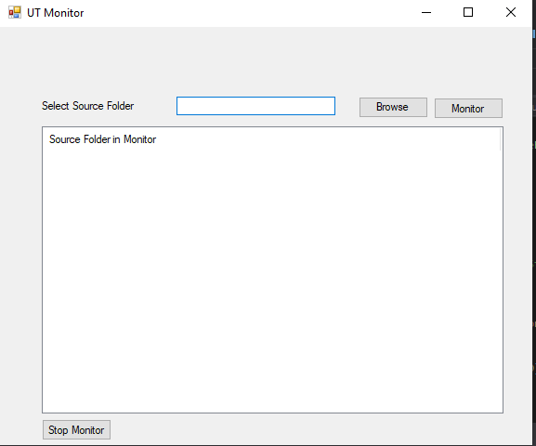
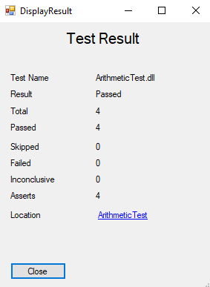
UI
UI contains 2 elements
SourceView for adding and removing source control from monitor
DisplayResult is for showing result back to user for the changed project

Slide 7
FileWatcher
FileWatcher class contain function which will call the FileSystemWatcher which will watch the given directory and see for all changes and will fire a event whenever it detects a change in file.
This change is then filtered by the DLL Filter class which will only allow project DLL go for the further process to the Driver Class

Slide 8
Driver
Driver Class gets the Project DLL location from the FileWatcher class and perform the finding of the NUnit test cases, executing them and getting its result from the test file.
It will finally return the test data Dictionary back to the UI which will display it to the user.

Slide 9
NUnitFinder
It gets the project name and source control location to find the test case in the given source control.
It will return the location of where the test cases are present in the given Source Control

Slide 10
RunNUnit
It takes input of test case file location, project location and projectName as input. It will perform the following function :
Copy the project DLL to test folder
Open Nunit console
Execute testcase DLL in console

Slide 11
XMLParse
It takes input of test case result location as input and read the given file to create Dictionary for sending the data back to the UI

Slide 12
Invoker
It is Delegate definition class which is used for sending the data from backend to the UI Asynchronously. It sends the data from backend to UI for output.
It is used to send exception detail to the user
Sending TestResult data to User
Sending source control List

Slide 13
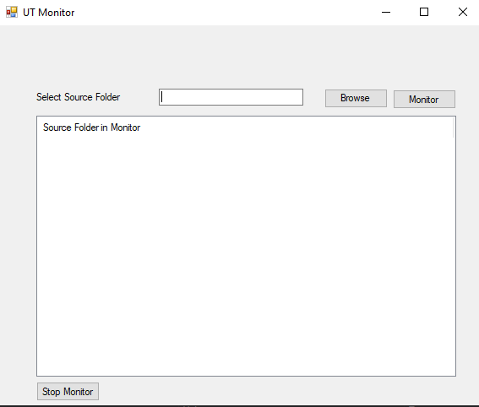
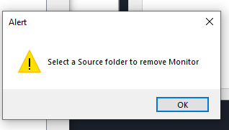
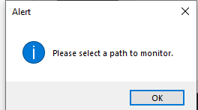
Sample Output

Slide 14
Project Flow
UI
FileWatcher
Driver
NUnitFinder
RunNUnit
XMLParser
UI
Takes Input of Source Control
Run FileWatcher for given Source Control
Takes flow to all class
Find Nunit TestCase
Execute NUnit TestCase
Read and parse XML result file to Dictionary
Display test result to user

Slide 15
Issues Faced
All the FileWatcher event are created in Main thread Pool so it can not be destroyed.
DLL changing multiple time of same project so event is fired many times
Same DLL is present in 2 different location
Sending data back from event to the UI

Slide 16
Demo

Slide 17
Questions

Slide 18
Thank you!

